Slide 1
Trees

Slide 2
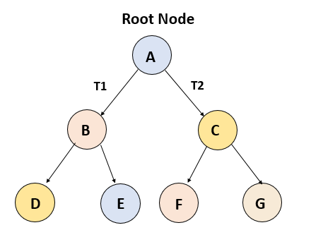
Types of Trees
General Tree:
No constraint on hierarchy of tree.
Every node may have infinite numbers of children.
Binary Tree:
Each node can have at max two child nodes.
This is more popular than most other trees.

Slide 3
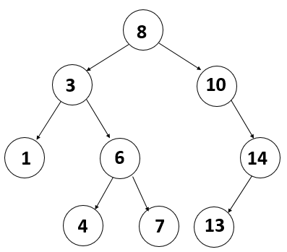
Types of Trees
Binary Search Tree:
Extension of Binary Tree
Value of left child should be less than or equal to the parent value for each node.
Value of right child should be greater than or equal to the parent value for each node.
Ideal for search operations.

Slide 4
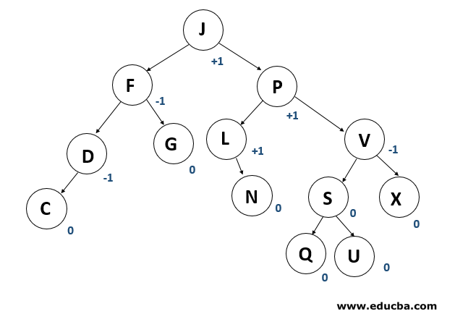
Types of Trees
AVL Trees
AVL tree is a binary search tree self-balancing.
A balancing factor is allocated for each node in the AVL tree, based on whether the tree is balanced or not.
The correct balance factor is either 1, 0 and -1.
If new node is added, then it will be rotated to ensure that the tree is balanced.

Slide 5
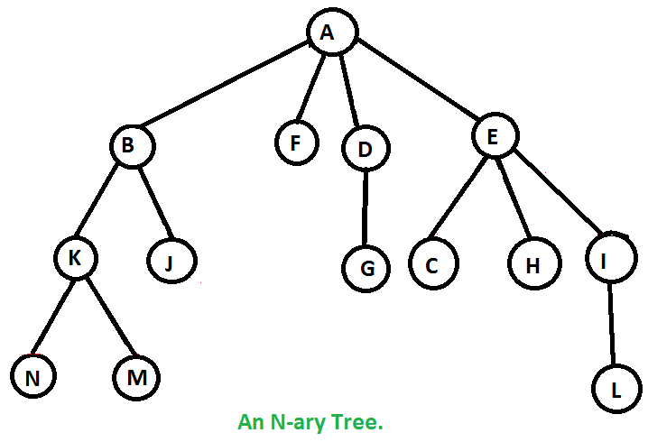
Types of Trees
N-ary Trees:
The maximum number of child nodes a parent node can have is N.
Similar to Binary tree

Slide 6
Basic Operations
Insertion - Inserting a new node.
Searching - Searching for a specific node
Traversal - Traversing the tree
Deletion - Deleting a node

Slide 7
Applications
Storing naturally hierarchical data. E.g: filesystems
Organizing data for quick search, insertion, deletion. E.g: Binary Search Trees.
Network Routing Algorithms
And much more ....

Slide 8
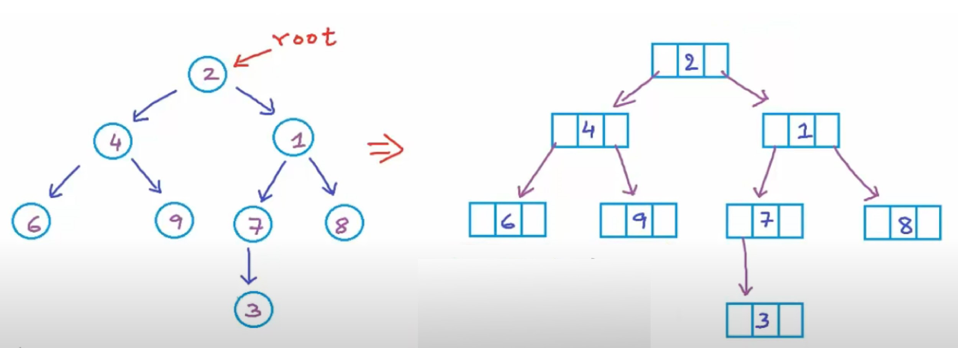
Representation
(Binary Trees)
struct Node {
int data;
Node* left;
Node* right;
};

Slide 9
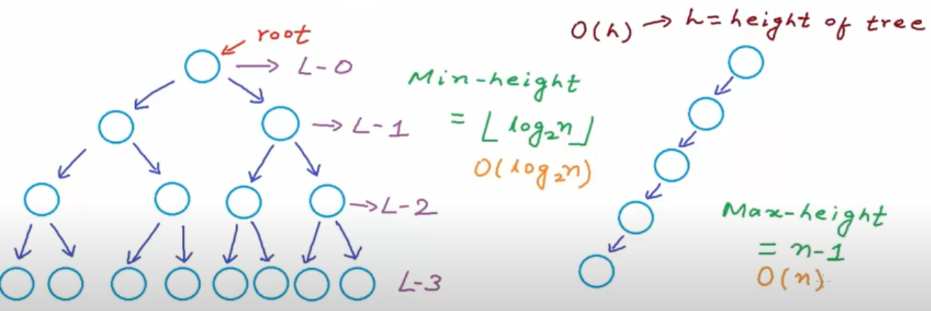
Complexity
(Binary Trees)

Slide 10
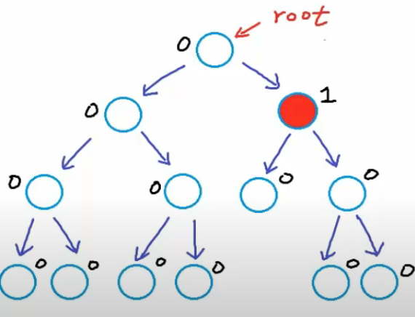
Balanced Binary Tree
For every node,
Difference between height of left and right subtree is not more than K (mostly 1).
Height of Tree:
No. of edges in longest path from root node to leaf node.
Diff = | h_{left} - h_{right} |
Height of empty tree = -1
Height of tree with one node = 0

Slide 11
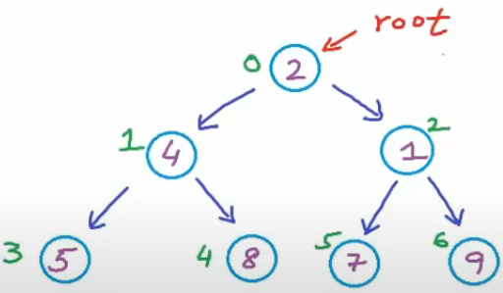
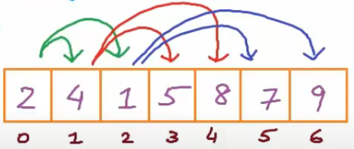
Implementation
(Binary Tree)
Binary Trees can be implemented using:
Dynamically created nodes
Arrays
struct Node {
int data;
Node* left;
Node* right; };
For node at index i,
Left-child-index = 2i+1
Right-child-index = 2i+2
In a complete binary tree

Slide 12
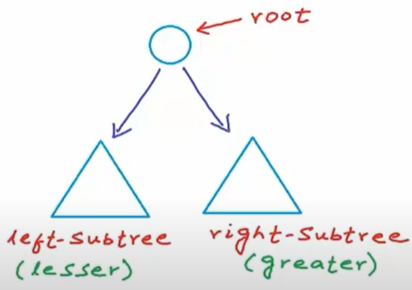
Representation
(Binary Search Tree)
Binary Search Tree (BST)
A binary tree in which for each node, values of all the nodes in left subtree is lesser or equal and the values of all the nodes in right subtree is greater.
left-subtree (keys) ≤ node (key) ≤ right-subtree (keys)

Slide 13
Implementation in C++
(Binary Search Tree)
#include<iostream>
using namespace std;
struct BstNode {
int data;
BstNode* left;
BstNode* right;
};
int main(){
BstNode* root; //pointer to root node
root = Null; //setting tree as empty
}
Creating an empty tree using this c++ code.
Structure definition of a node of tree.
Creating a node pointer and pointing that to null value to create an empty tree with root node pointing to null.

Slide 14
Implementation in C++
(Binary Search Tree) - Insert Operation
BstNode* GetNewNode(int data){
BstNode newNode = new BstNode();
newNode->data = data;
newNode->left = newNode->right = NULL;
return newNode;
}
BstNode* Insert(BstNode* root, int data){
if(root == NULL){ //empty tree
root = GetNewNode(data); }
else if(data <= root->data){
root->left = Insert(root->left, data); }
else{
root->right = Insert(root->right, data); }
return root;
}
Function to create a new node.
Function to insert the node in the tree based on different conditions.

Slide 15
Implementation in C++
(Binary Search Tree) - Search Operation
bool Search(BstNode* root, int data){
if (root == NULL) return false;
else if(root->data == data) return true;
else if(root->data <= data) return Search(root->left, data);
else return Search(root->right, data);
}
Function to search for data in tree and return bool value.

Slide 16
Implementation in C++
(Binary Search Tree) - Main Function
int main(){
BstNode* root = NULL //creating an empty tree
root = Insert(root, 15); root = Insert(root, 10); root = Insert(root, 20);
root = Insert(root, 25); root = Insert(root, 8); root = Insert(root, 12);
int number;
cout<<”Enter the number to be searched\n”;
cin>>number;
if(Search(root, number) == true) cout<<”Found\n”;
else cout<<”Not Found\n”;
}

Slide 17
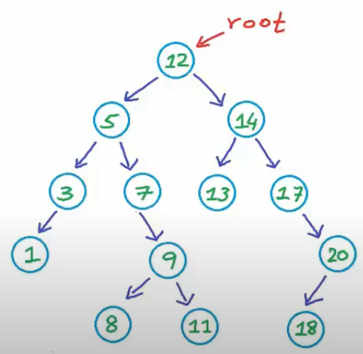
Delete Operation
(Binary Search Tree)
Case1: No Child
Case2: One Child
Case3: Two Children
Find minimum node in right;
Copy the value in targeted node;
Delete duplicate from right-subtree;
Find maximum node in left;
Copy the value in targeted node;
Delete duplicate from left-subtree;

Slide 18
Implementation in C++
(Binary Search Tree) - Delete Operation
BstNode* Delete(BstNode* root, int data){
if (root == NULL) return root;
else if(data < root->data) root->left = Delete(root->left, data);
else if(data> root->data) root->right = Delete(root->right, data);
else{//found the node to be deleted
//code to delete the node and rearrange the
//remaining nodes in different cases.
}
return root;
}

Slide 19
Implementation in C++
(Binary Search Tree) - Delete Operation
{//logic continued
if(root->left == NULL && root->right == NULL){
//Case1: No child
delete root;
root = NULL;
}
//other cases
}

Slide 20
Implementation in C++
(Binary Search Tree) - Delete Operation
//logic continued
//Case2 : One Child
//no left subtree
else if(root->left == NULL){
BstNode* temp = root;
root = temp->right;
delete temp;
}
//no right subtree

Slide 21
Implementation in C++
(Binary Search Tree) - Delete Operation
else if(root->right == NULL){
BstNode* temp = root;
root = temp->left;
delete temp;
}
else{ //Case 3: Two children
BstNode* temp = FindMin(root->right);
root->data = temp->data;
root->right = Delete(root->right, temp->data);
}
}
This function returns the node with minimum value in that subtree.

Slide 22
Traversal Operations
(Binary Search Tree)
Breadth First Traversal (or Level Order Traversal)
Depth First Traversals
Preorder Traversal (Root-Left-Right)
Inorder Traversal (Left-Root-Right)
Postorder Traversal (Left-Right-Root)
NOTE: In all the above traversals, we visit every node exactly once. This costs:
O(n) time complexity
O(h) space complexity(for Depth first traversals) (for Breadth First Traversal)
in worst case: O(n) in worst/average case: O(n)
In best/average case: O(logn) in best case: O(1)

Slide 23
Implementation in C++
(Binary Search Tree) - Traversal
Preorder Traversal:
Until all nodes are traversed:
Step1: Visit Root Node
Step2: Recursively traverse left subtree.
Step3: Recursively traverse right subtree.
Code:
void preorder(BstNode* root){
if (root != NULL){
cout<<root->data<<" ";
preorder(root->left);
preorder(root->right);
}
}
Time Complexity: O(n)
Space Complexity: O(h)

Slide 24
Implementation in C++
(Binary Search Tree) - Traversal
Inorder Traversal:
Until all nodes are traversed:
Step1: Recursively traverse left subtree.
Step2: Visit Root Node
Step3: Recursively traverse right subtree.
Code:
void inorder(BstNode* root){
if (root != NULL){
inorder(root->left);
cout<<root->data<<" ";
inorder(root->right);
}
}
Time Complexity: O(n)
Space Complexity: O(h)

Slide 25
Implementation in C++
(Binary Search Tree) - Traversal
Postorder Traversal:
Until all nodes are traversed:
Step1: Recursively traverse left subtree.
Step2: Recursively traverse right subtree.
Step3: Visit Root Node
Code:
void postorder(BstNode* root){
if (root != NULL){
postorder(root->left);
postorder(root->right);
cout<<root->data<<" ";
}
}
Time Complexity: O(n)
Space Complexity: O(h)

Slide 26
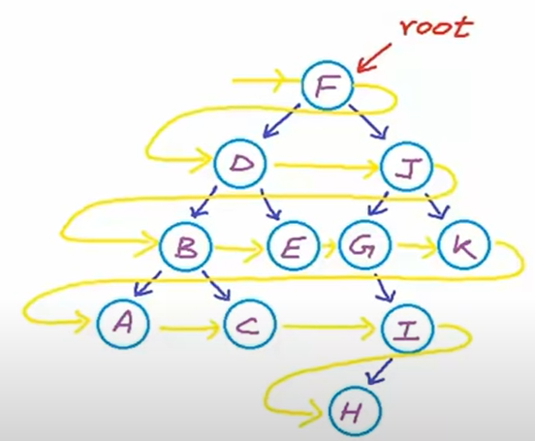
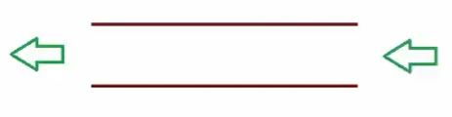
Implementation in C++
(Binary Search Tree) - Level Order Traversal
void LevelOrder(BstNode* root){
if (root == NULL)return;
queue<BstNode*> Q;
Q.push(root);
//while there is at least one discovered node
while(!Q.empty()){
BstNode* current = Q.front();
cout<<current->data<<” “;
if(current->left !=NULL) Q.push(current->left);
if(current->right !=NULL) Q.push(current->right);
Q.pop(); } //removing the element at front
}
Level Order: F, D, J, B, E, G, K, A, C, I, H
Can implement using Queue (FIFO)

Slide 27
Program
Given a binary tree, check whether the binary tree is a Binary Search Tree (BST) or not.

Slide 28
Solution 1
struct Node{
int data;
Node* left;
Node* right;
};
bool IsBinarySearchTree(Node* root){
//return True if BST, false otherwise
}

Slide 29
Solution 1
bool IsSubtreeLesser(Node* root, int value);
bool IsSubtreeGreater(Node* root, int value);
bool IsBinarySearchTree(Node* root){
if (root == NULL) return true;
if(IsSubtreeLesser(root->left, root->data)
&& IsSubtreeGreater(root->right, root->data)
&& IsBinarySearchTree(root->left)
&& IsBinarySearchTree(root->right))
return true;
else
return false;
}

Slide 30
Solution 1
bool IsSubtreeLesser(Node* root, int value){
if(root == NULL) return true;
if(root->data <= value
&& IsSubtreeLesser(root->left, value)
&& IsSubtreeLesser(root->right, value))
return true;
else
return false;
}

Slide 31
Solution 1
bool IsSubtreeGreater(Node* root, int value){
if(root == NULL) return true;
if(root->data > value
&& IsSubtreeGreater(root->left, value)
&& IsSubtreeGreater(root->right, value))
return true;
else
return false;
}

Slide 32
Solution
The IsSubtreeLesser() and IsSubtreeGreater() are very expensive as for each node we are looking at all nodes in its subtree.
To overcome this,
We can introduce a permissible range in which the data in the node must be in that range.

Slide 33
Solution 2
bool IsBSTHelper(Node* root, int minValue, int maxValue){
if(root == NULL) return true;
if(root->data > minValue && root->data < maxValue
&& IsBSTHelper(root->left, minValue, root->data)
&& IsBSTHelper(root->right, root->data, maxValue))
return true;
else
return false;
}
bool IsBinarySearchTree(Node* root){
return IsBSTHelper(root, INT_MIN, INT_MAX);
}

Slide 34
Comparison
Solution 1:
Time Complexity = O(n²)
Solution 2:
Time Complexity = O(n)

Slide 35
Is there any other possible solution to this problem ?
Notes:
Hint: using Inorder traversal

